Slide 1
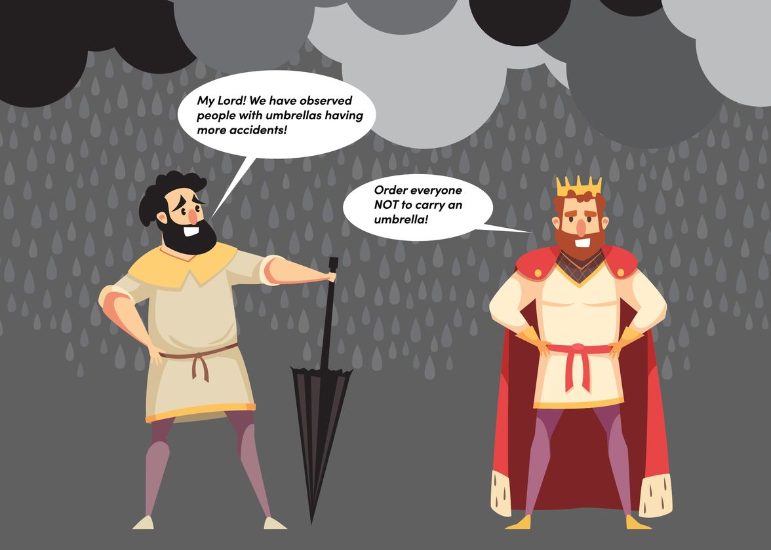
https://www.aboutwayfair.com/tech-innovation/the-importance-of-covariates-in-causal-inference

Slide 2



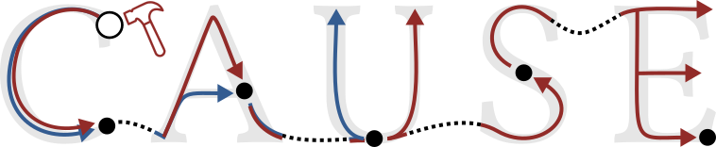
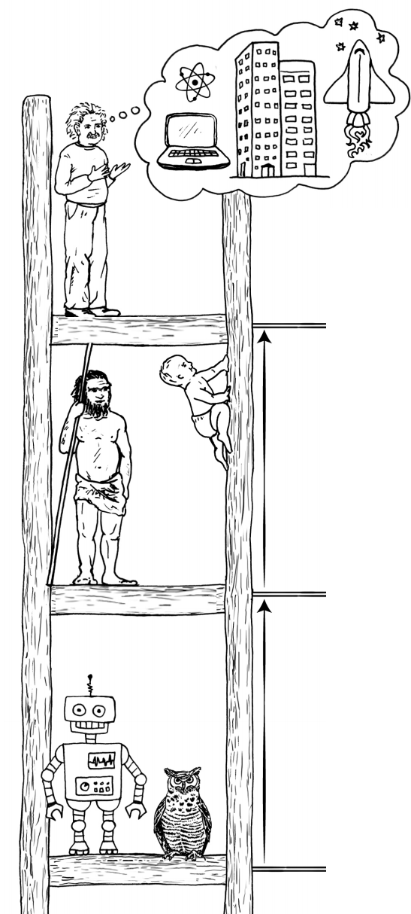

Machines Climbing Pearl’s Ladder of Causation
Devendra Singh Dhami
Matej Zečević
Adele Ribeiro
Machines Climbing Pearl’s Ladder of Causation

Slide 3

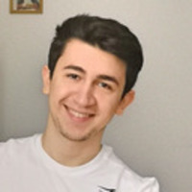
A Quick Introduction
Devendra Singh Dhami
Independent Research Group Leader at TU Darmstadt and Hessian Center for Artificial Intelligence (hessian.AI)
Matej Zečević
PhD student at the Artificial Intelligence and Machine Learning Lab at TU Darmstadt
Adèle Ribeiro
Postdoctoral Researcher at Philipps-Universität Marburg
Machines Climbing Pearl’s Ladder of Causation

Slide 4
5 Thrilling Days
Day 1: Introduction to Causality (Devendra)
Day 2: Representation of Causal Knowledge and Causal Discovery (Adèle)
Day 3: Causal Identification and Estimation (Matej)
Day 4: Hands-on Session (Matej)
Day 5: Current state of Research in Causality (Devendra and Adèle)
Machines Climbing Pearl’s Ladder of Causation

Slide 5
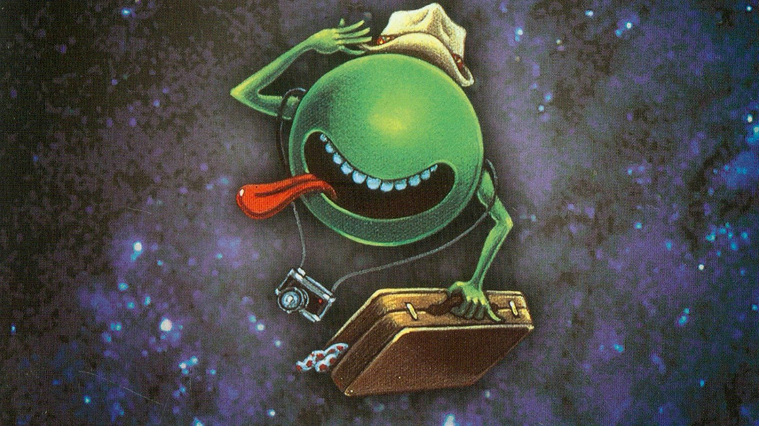
The Ultimate
Hitchhiker’s Introduction to Causality for ML
Devendra Singh Dhami
Machines Climbing Pearl’s Ladder of Causation

Slide 6
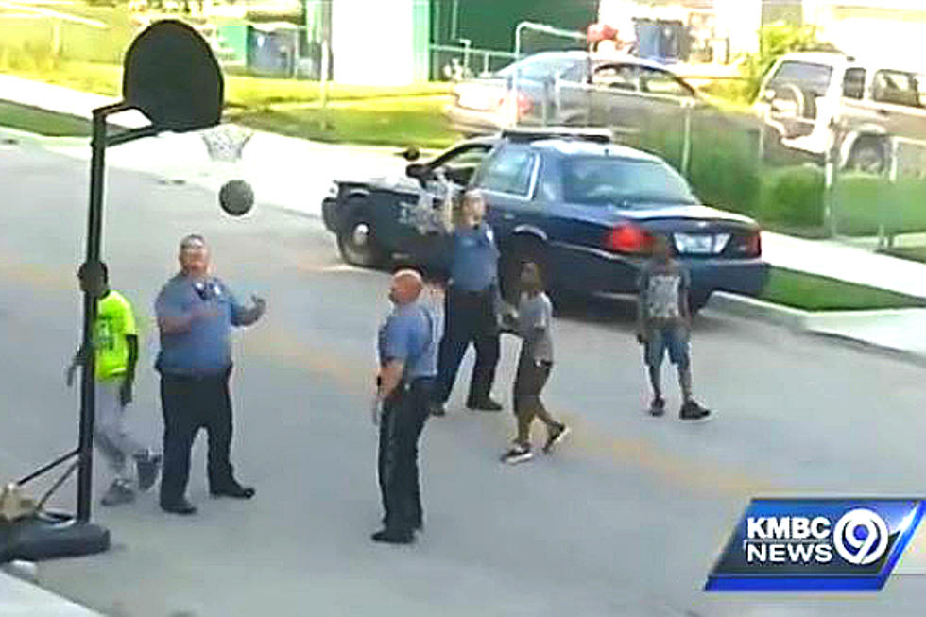
Machines Climbing Pearl’s Ladder of Causation

Slide 7
Machines Climbing Pearl’s Ladder of Causation

Slide 8
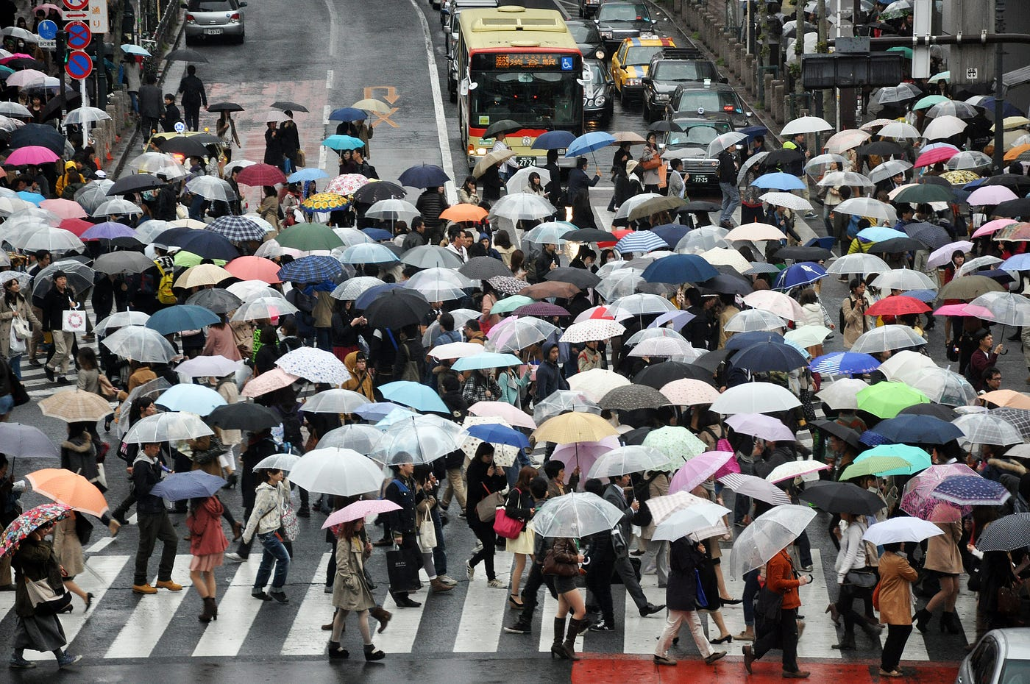
Machines Climbing Pearl’s Ladder of Causation

Slide 9
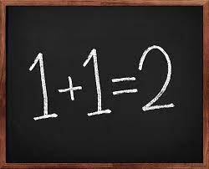
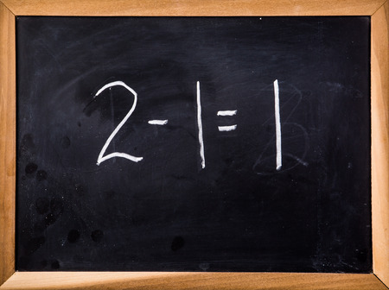
Causality is hard
Machines Climbing Pearl’s Ladder of Causation
Notes:
What is the cause?

Slide 10
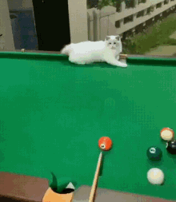
Causality is hard(er)
Machines Climbing Pearl’s Ladder of Causation
Notes:
What is the cause?

Slide 11
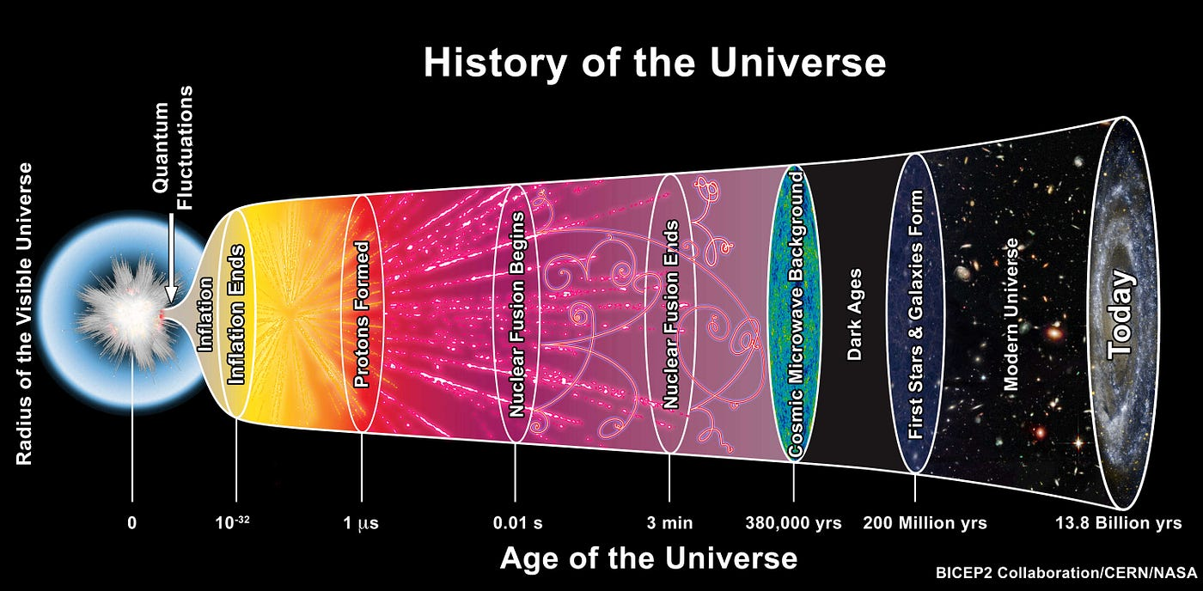
Carl Sagan: If you wish to make an apple pie from scratch, you must first invent the universe
Notes:
Or we need to go back to the beginning of the universe? key problems of defining causation: 1. We need a way to separate objects and events unambiguously into either causes or effects.
2. We need to figure out how to limit the number of objects/events we include in order to create a useful concept of causation.

Slide 12
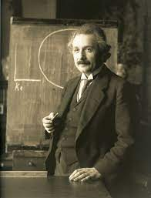
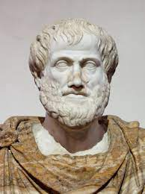
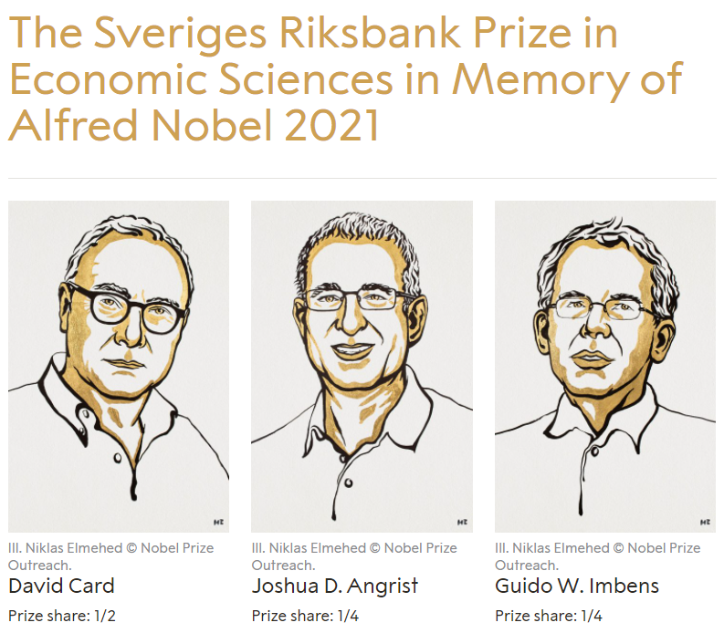
Causality is Omnipresent!
Classical Physics: An effect cannot occur from a cause that is not in the back (past) light cone of that event. Similarly, a cause cannot have an effect outside its front (future) light cone
Philosophy: The material cause of a being is its physical properties or makeup. The formal cause is the structure or direction of a being. The efficient cause is the thing or agent, which actually brings it about. And the final cause is the ultimate purpose for its being
Economics: Develops explicit models of outcomes where the causes of effects are investigated and the mechanisms governing the choice of treatment are analyzed
Machines Climbing Pearl’s Ladder of Causation

Slide 13
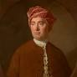
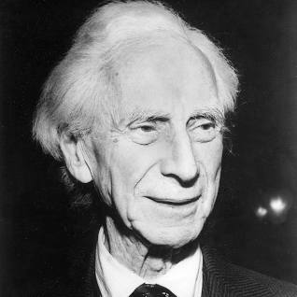
Causality is Omnipresent?
David Hume: Causation is a relationship between two impressions or ideas in the mind.
Because causation is defined by experience, any cause-and-effect relationship could be incorrect because thoughts are subjective and therefore causality cannot be proven
Barber’s Paradox: There is a village where the barber shaves all those and only those who do not shave themselves. Who shaves the barber?
A causal problem Are the non-shavers actually non-shavers because they're shaved by the barber or whether they're shaved by the barber because they're non-shavers. If the first is true, the barber is a member of both groups: he shaves himself and is shaved by the barber. If the second is true, the situation is paradoxical.
Machines Climbing Pearl’s Ladder of Causation

Slide 14
1
Why?
Machine Learning needs Causality?
Machines Climbing Pearl’s Ladder of Causation

Slide 15
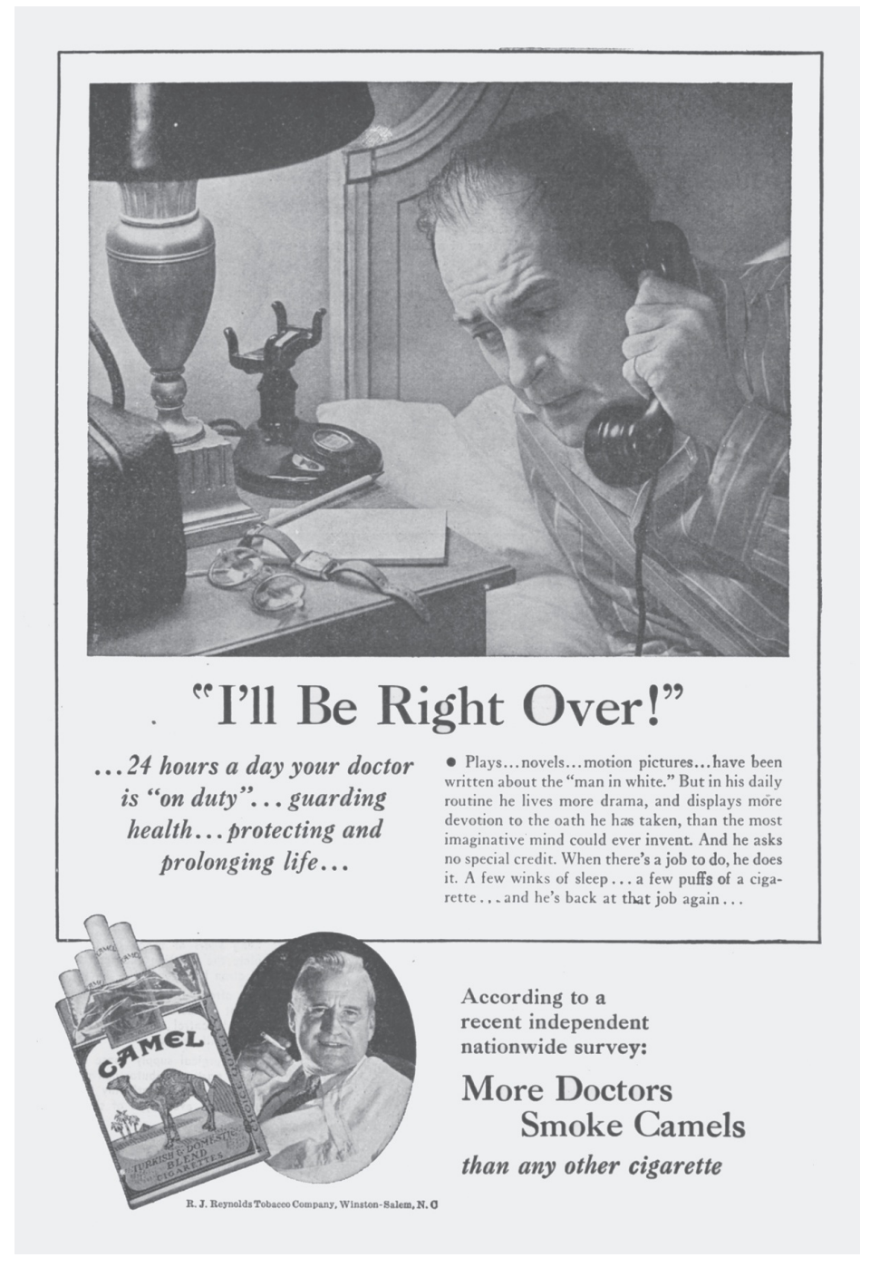
Pearl and Mackenzie, The Book of Why, 2017
Machines Climbing Pearl’s Ladder of Causation

Slide 16
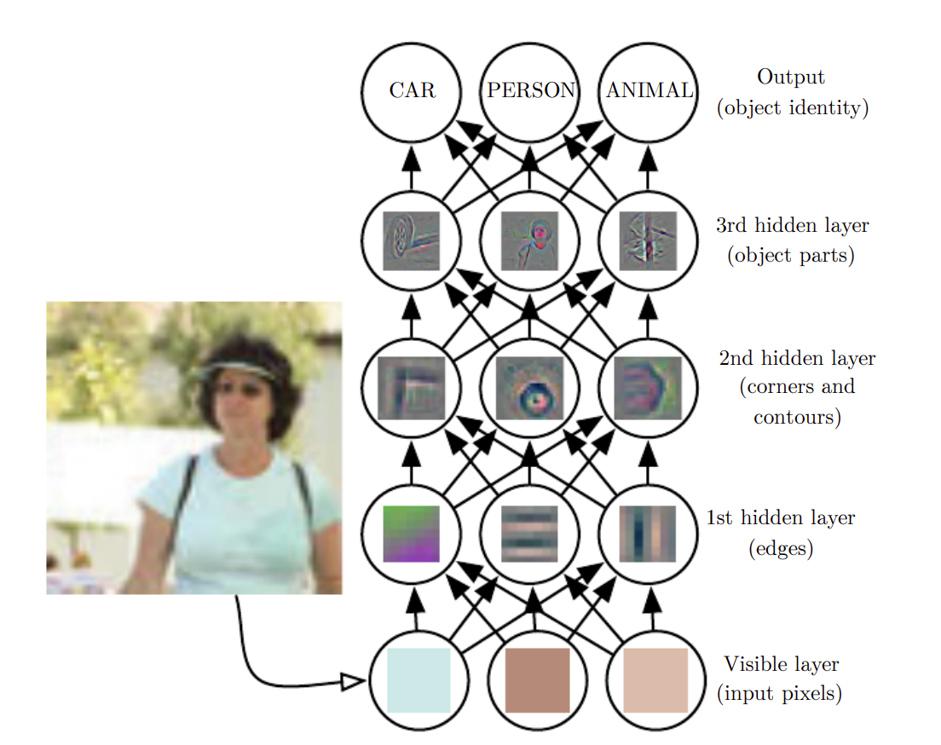
Current Trend: Deep Learning
Goodfellow et al., Deep Learning, MIT Press, 2017
Machines Climbing Pearl’s Ladder of Causation

Slide 17
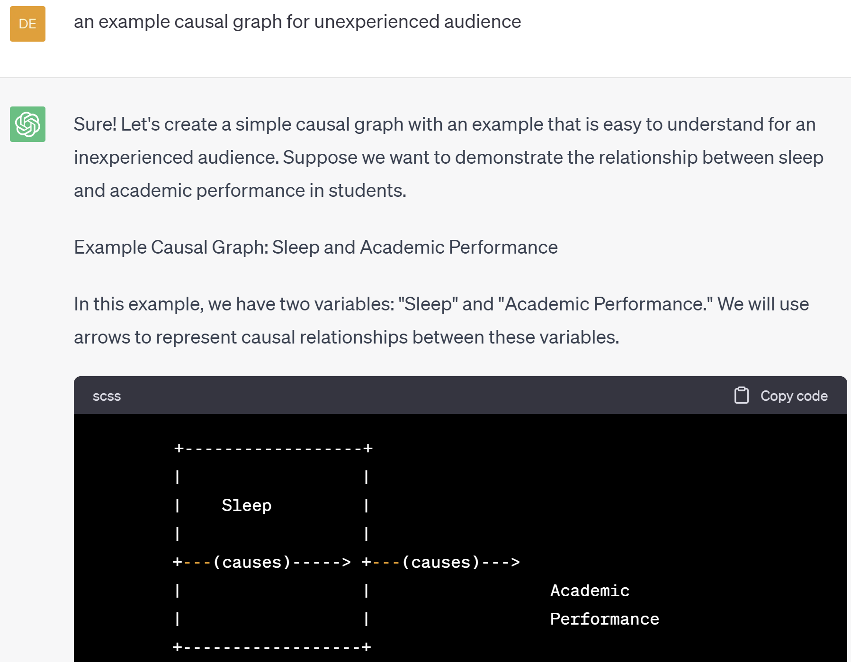
Current Trend: Deep Learning
Machines Climbing Pearl’s Ladder of Causation

Slide 18
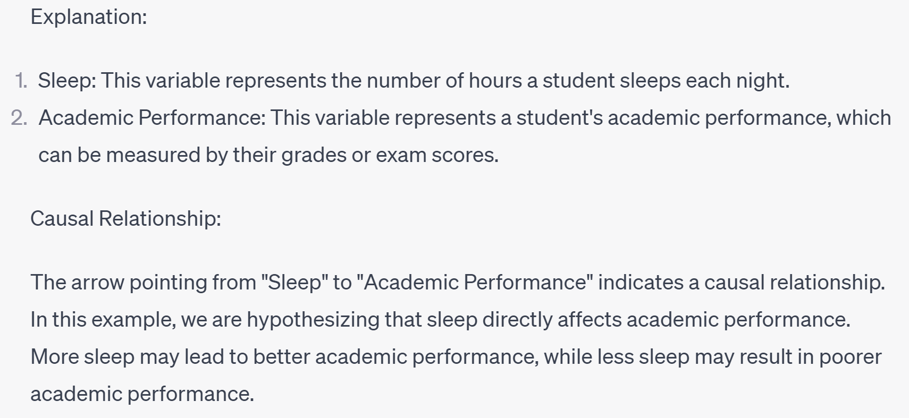
Current Trend: Deep Learning
Machines Climbing Pearl’s Ladder of Causation

Slide 19
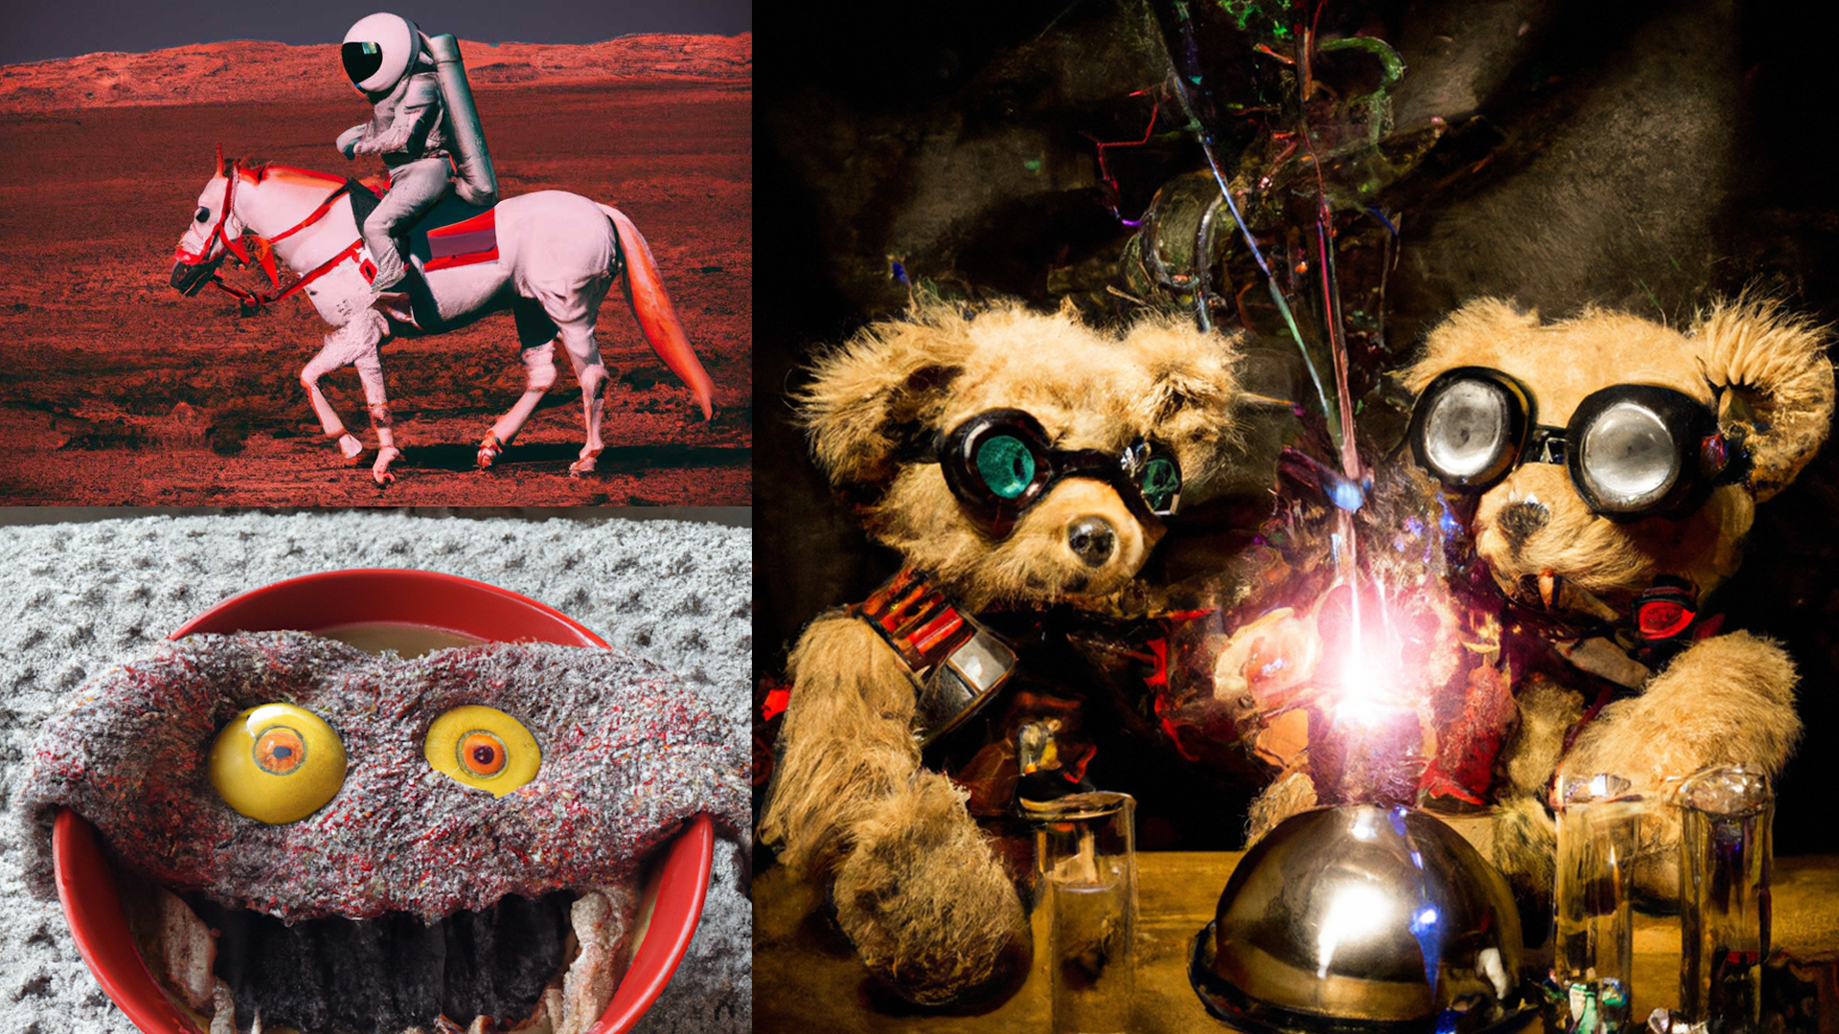
Current Trend: Deep Learning
Machines Climbing Pearl’s Ladder of Causation

Slide 20
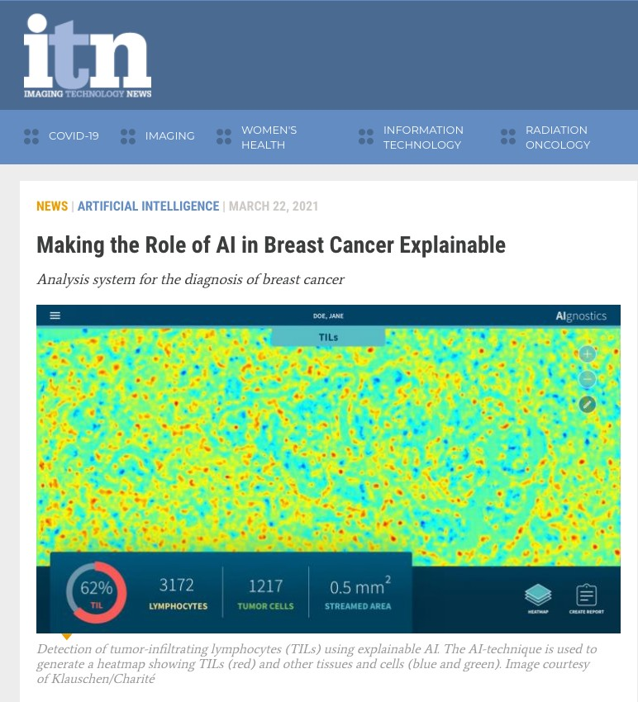
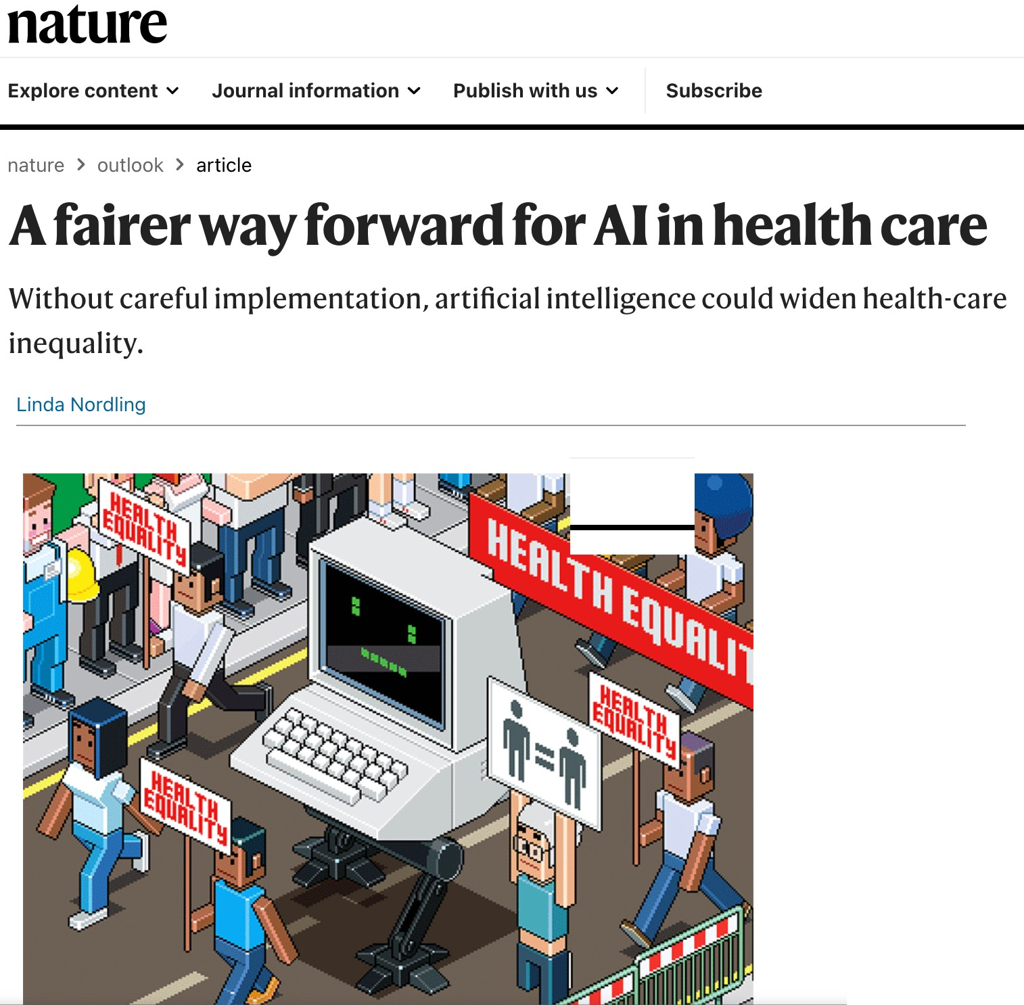
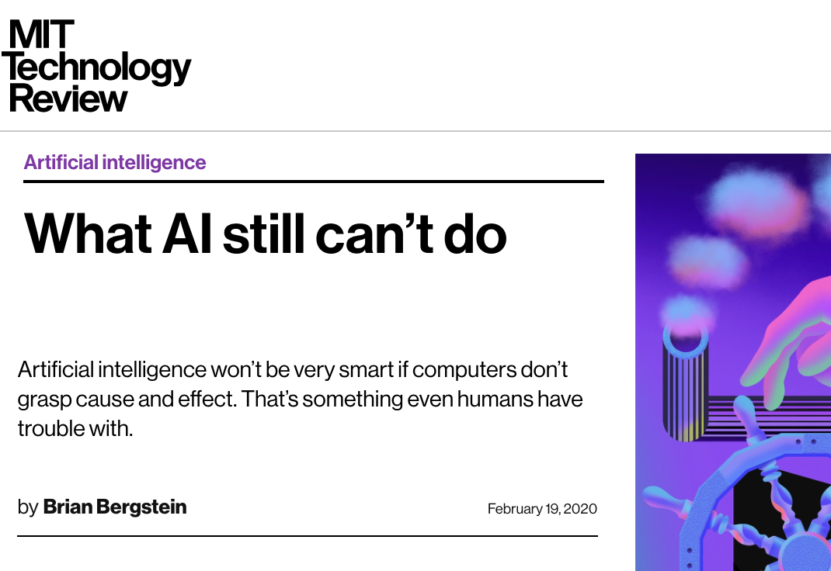
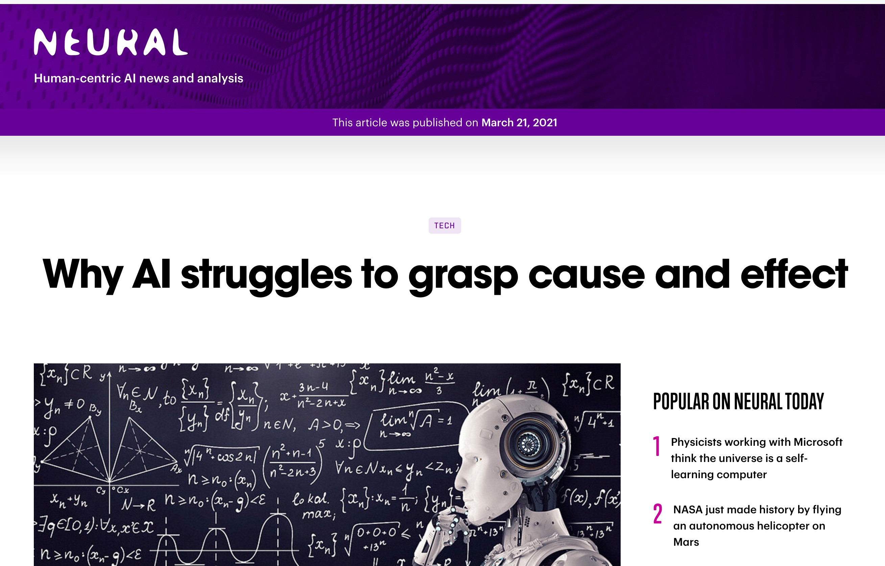

Current Challenges in DS, AI, ML
Machines Climbing Pearl’s Ladder of Causation

Slide 21

Current Challenges in DS, AI, ML
Data-hungry & sample inefficiency
Lack of interpretability & explainability
Lack of robustness & generalizability
Unfair & unethical decision-making
👩🏫
Lack of Causal Inference Capabilities
5
Machines Climbing Pearl’s Ladder of Causation

Slide 22
What can we achieve with causality?
Data Fusion: provides language and theory to cohesively combine prior knowledge and data from multiple and heterogeneous studies.
Effect identifiability: can determine the effect of unrealized interventions rather than just predicting an outcome (i.e., can distinguish between association and causation)
Generalizability: allows the transportability of causal effects across different domains.
Explainability: provides a better understanding of the underlying mechanisms.
Fairness: captures and disentangles any mechanisms of discrimination that may be present, including direct, indirect-mediated, and indirect-confounded.
Machines Climbing Pearl’s Ladder of Causation

Slide 23
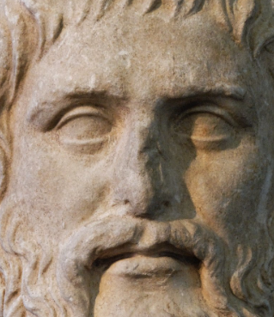
What is Causality?
We might want to start here first..
Probably, Plato was the first to state the principle of causality: “Every­thing that becomes or changes must do so owing to some cause; for nothing can come to be without a cause.”- Timaeus 28a
Machines Climbing Pearl’s Ladder of Causation

Slide 24
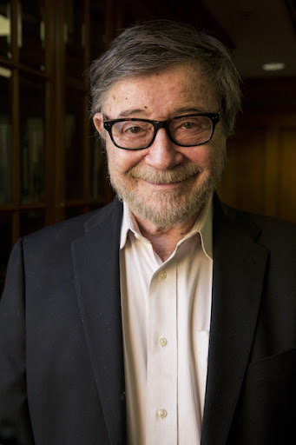

Judea Pearl’s opinion
Pioneer of Causality for AI, Turing awardee
“To Build Truly Intelligent Machines, Teach Them Cause and Effect”
“All the impressive achievements of deep learning amount to just curve fitting”
Judea Pearl in “The Book of Why” and in an interview with quanta magazine in 2018
Machines Climbing Pearl’s Ladder of Causation

Slide 25
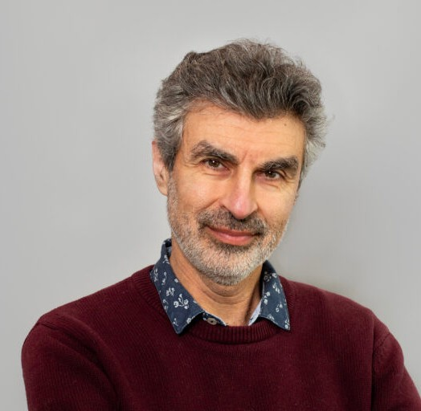



Yoshua Bengio’s opinion
Pioneer of Deep Learning, Turing awardee
“..for conceptual and engineering breakthroughs that have made deep neural networks a critical component of computing.”
“Causality is very important for the next steps of progress of machine learning,”
Yoshua Bengio in an interview with IEEE Spectrum, 2020
.
Machines Climbing Pearl’s Ladder of Causation

Slide 26
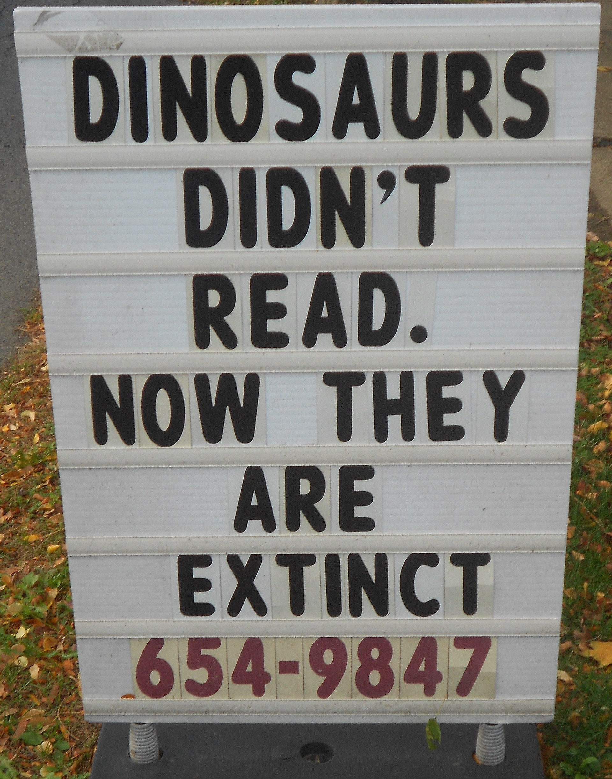
We have All Heard the Phrase
“Correlation does not imply causation”
Correlation
Causation
Correlation
Causation
Pic Credit: Wikipedia
Machines Climbing Pearl’s Ladder of Causation

Slide 27
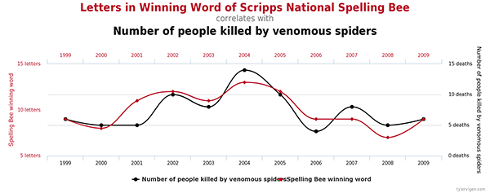
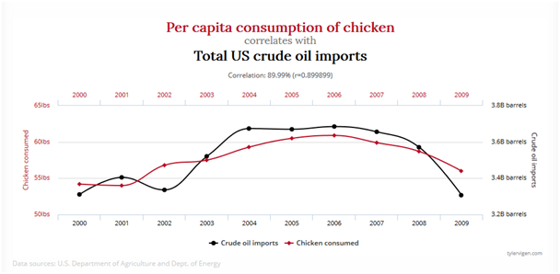
Correlation ∩ Causality = Ø
Machines Climbing Pearl’s Ladder of Causation

Slide 28
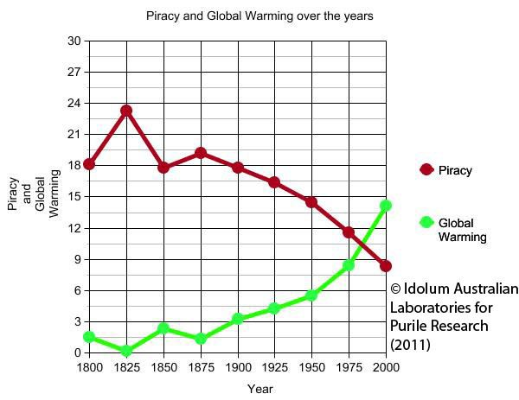
Correlation => Causality via a third factor
Machines Climbing Pearl’s Ladder of Causation

Slide 29
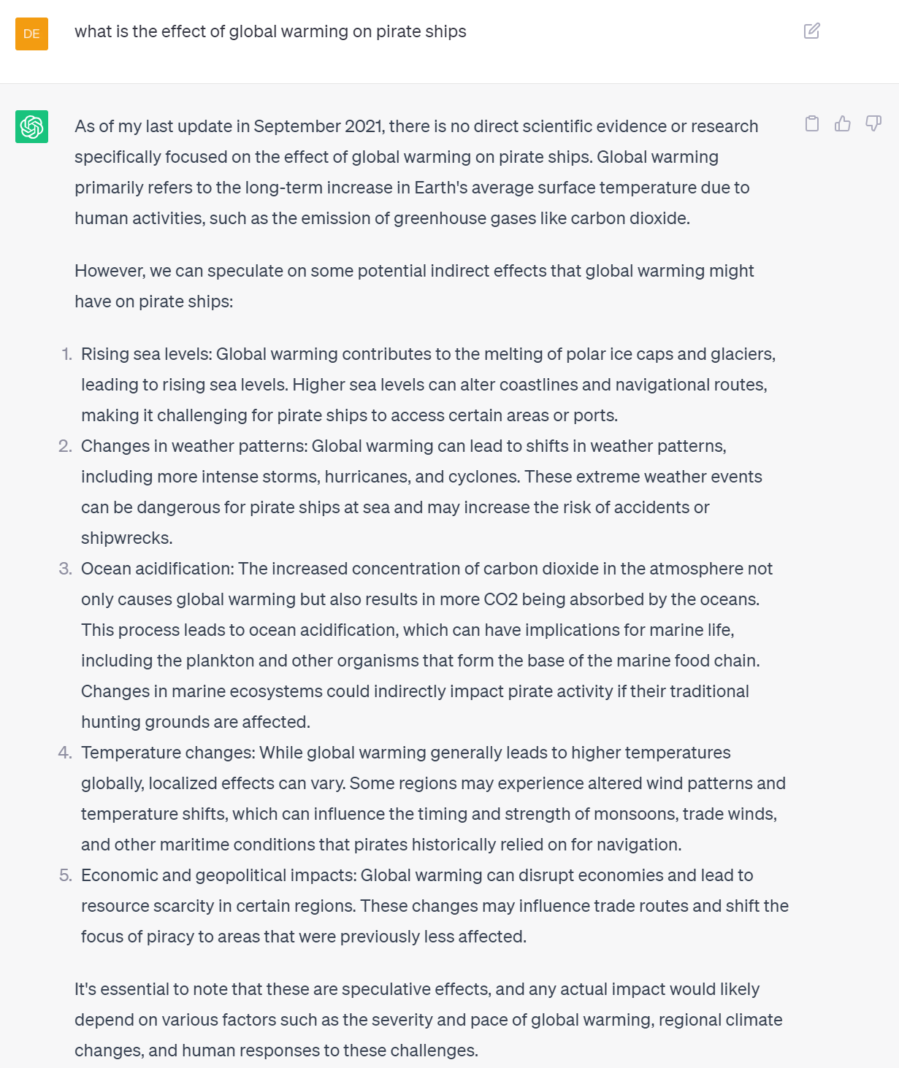
Machines Climbing Pearl’s Ladder of Causation

Slide 30
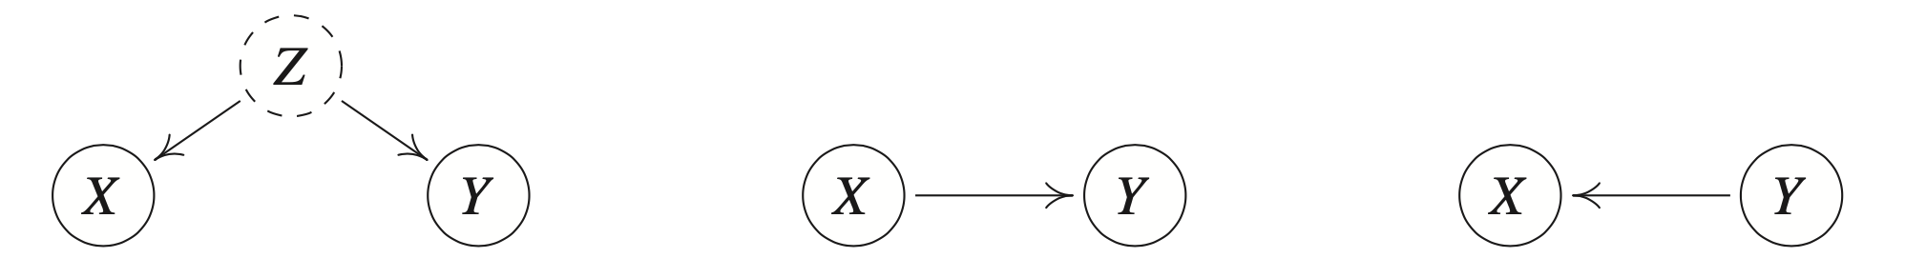
Reichenbach’s Common Cause Principle
Defining Confounders
Reichenbach’s Direction of Time (1956)
Machines Climbing Pearl’s Ladder of Causation

Slide 31
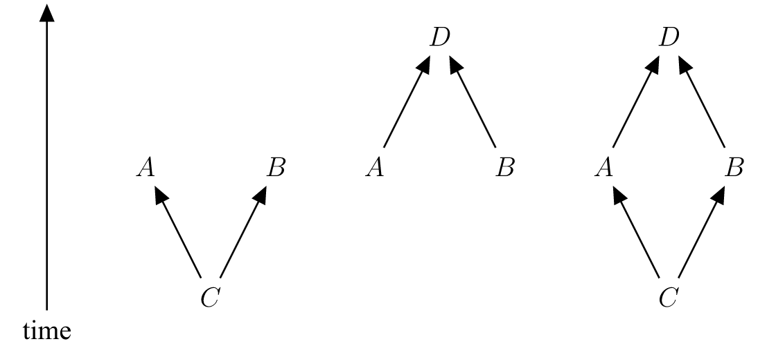
Reichenbach’s Common Cause Principle
Conjunctive fork: a) open to the future b) open to the past c) closed fork
https://plato.stanford.edu/entries/physics-Rpcc/
Machines Climbing Pearl’s Ladder of Causation

Slide 32
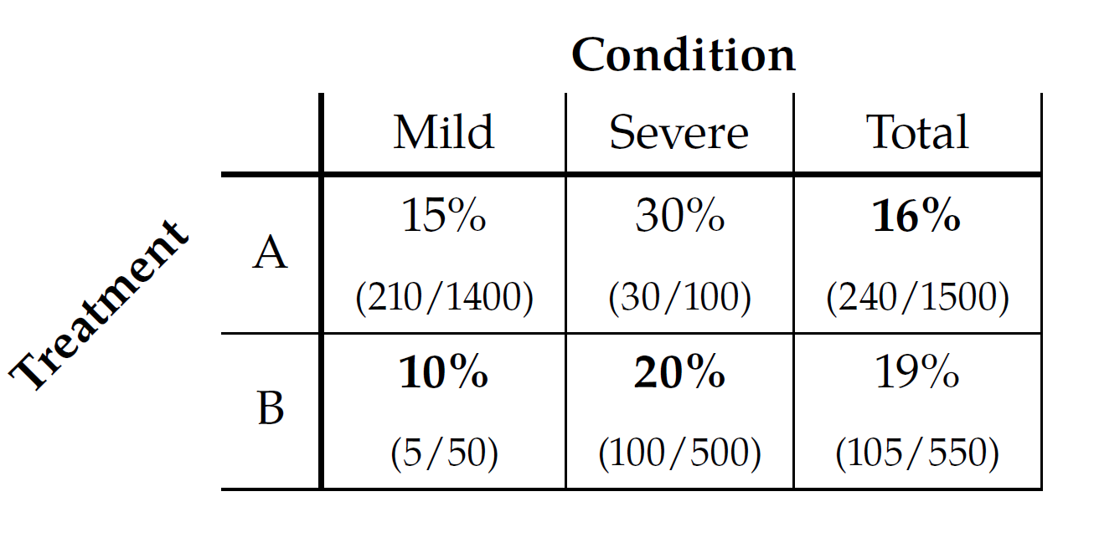
Let’s Illustrate Correlation does not imply causation: Simpson’s Paradox
Credit: Brady Neal Course
more effective treatment is completely dependent on the
causal structure of the problem
Machines Climbing Pearl’s Ladder of Causation

Slide 33
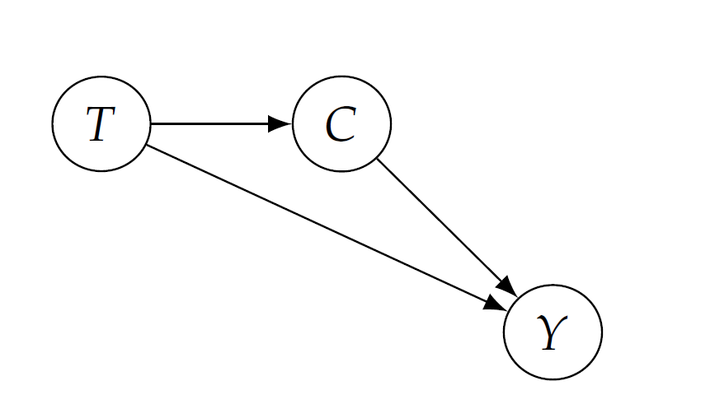
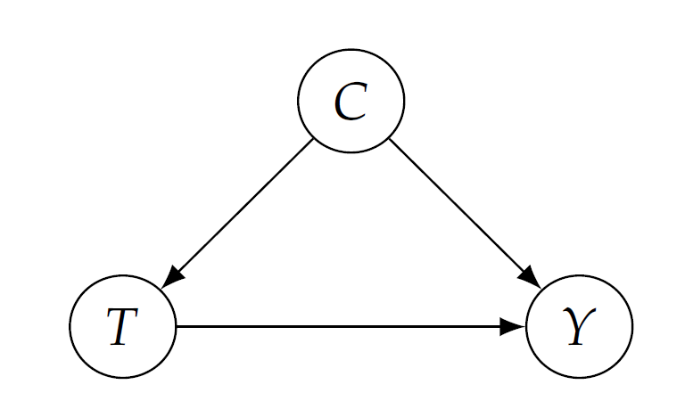
Let’s Illustrate Correlation does not imply causation : Simpson’s Paradox
Scenario 1: Confounders
Scenario 2: Treatment causes condition
Treatment A preferable
Treatment B preferable
Machines Climbing Pearl’s Ladder of Causation
Notes:
Talk about causal and confounding association

Slide 34
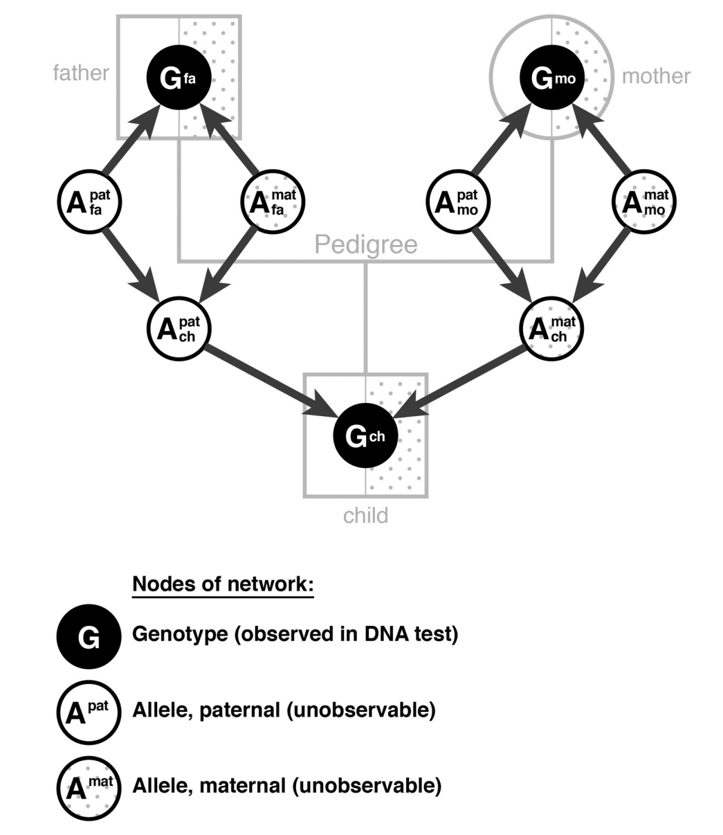
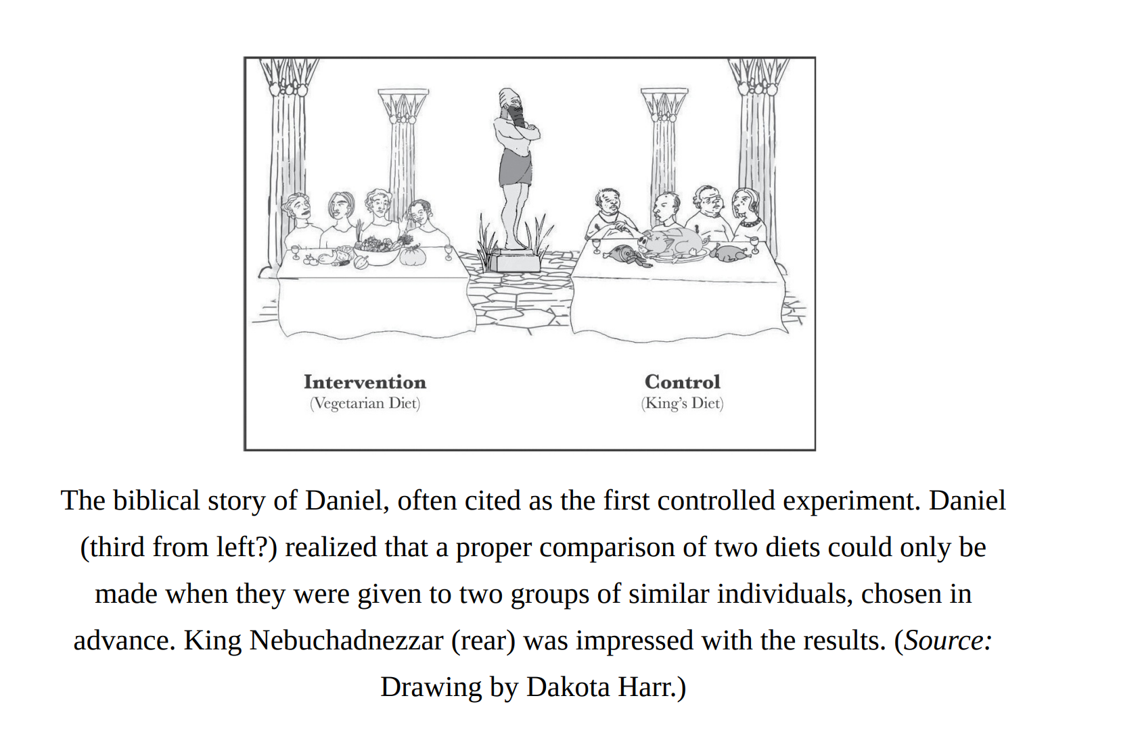
From Neyman-Rubin to Pearl
Potential Outcome theory to Bayesian networks and DAG’s
Machines Climbing Pearl’s Ladder of Causation

Slide 35
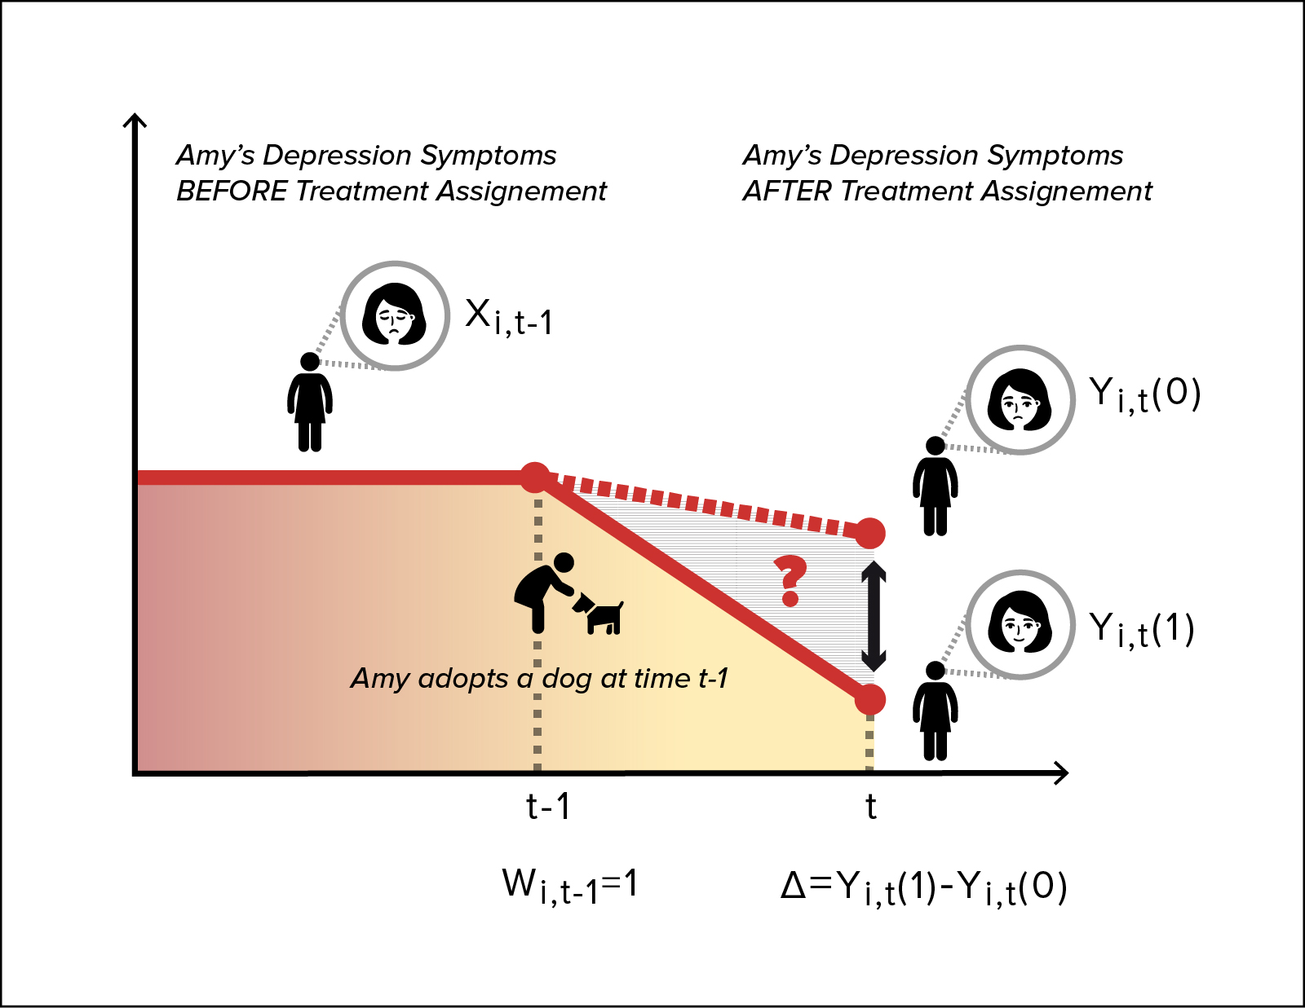
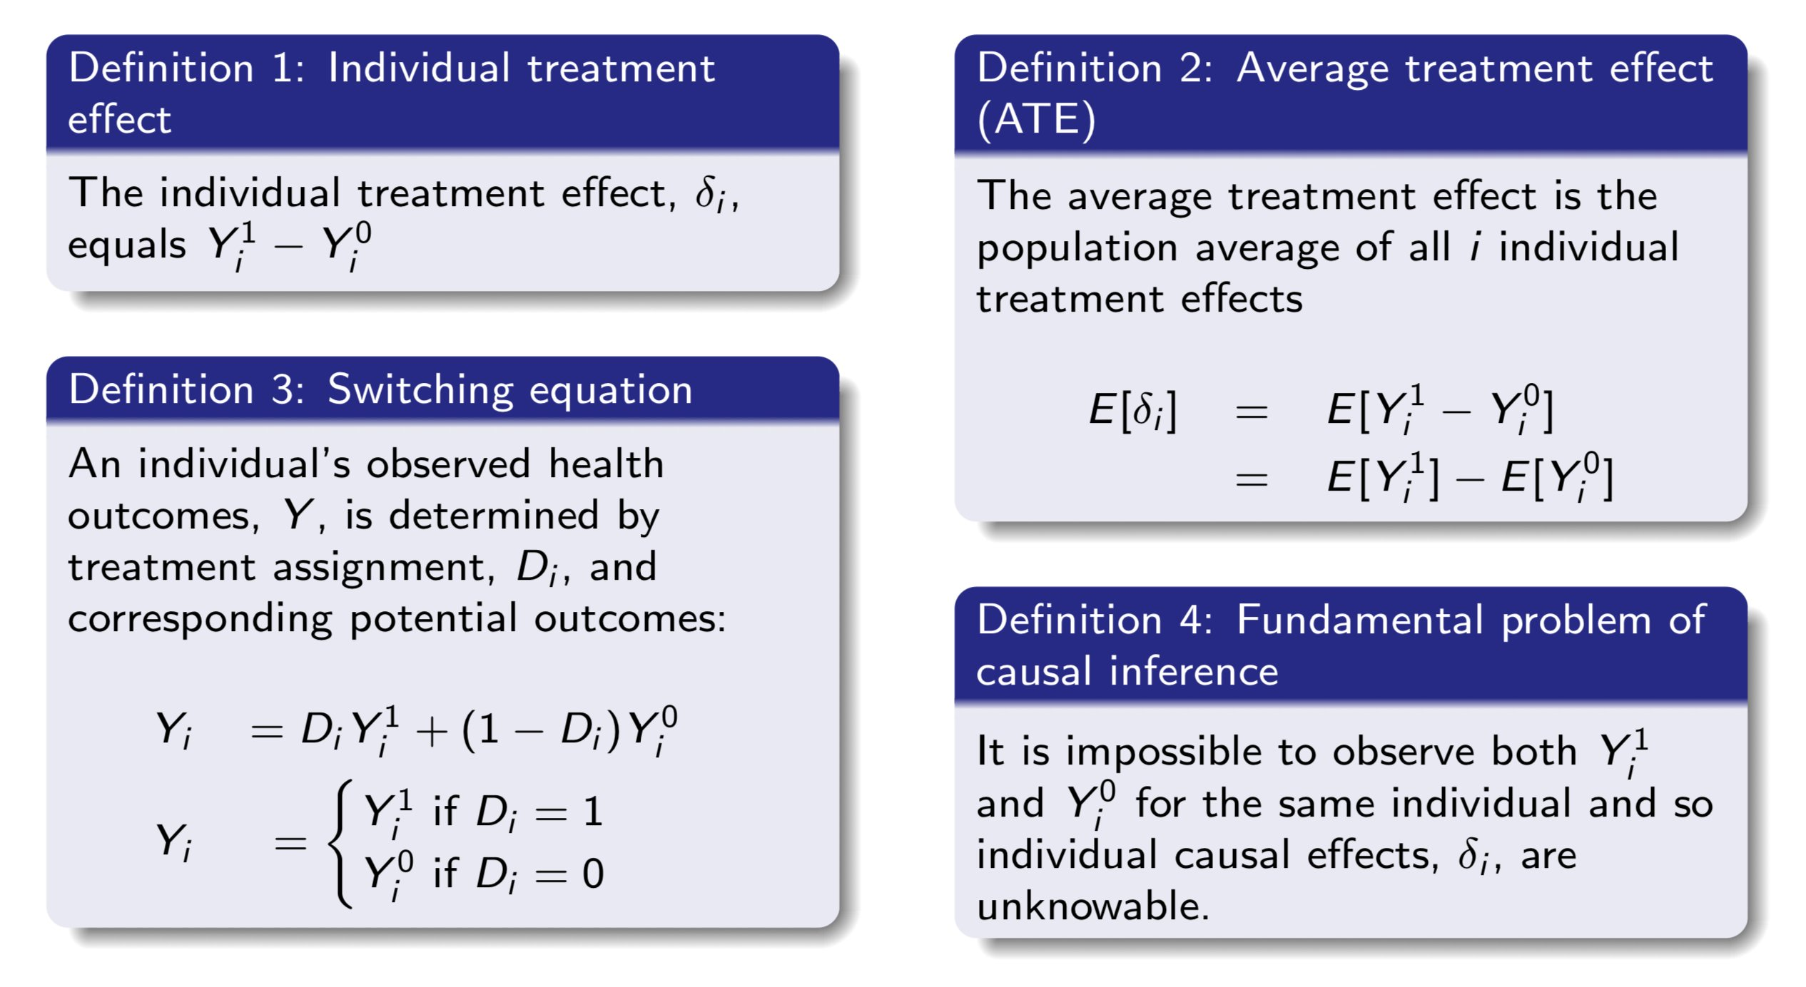
Fundamental Problems of Causal Inference
Credit: Dominici et al., From Controlled to Undisciplined Data: Estimating Causal Effects in the Era of Data Science Using a Potential Outcome Framework
Credit: Scott Cunningham
Machines Climbing Pearl’s Ladder of Causation
Notes:
Talk about counterfactualsATE (confounders needed), ITE (counterfactual)

Slide 36
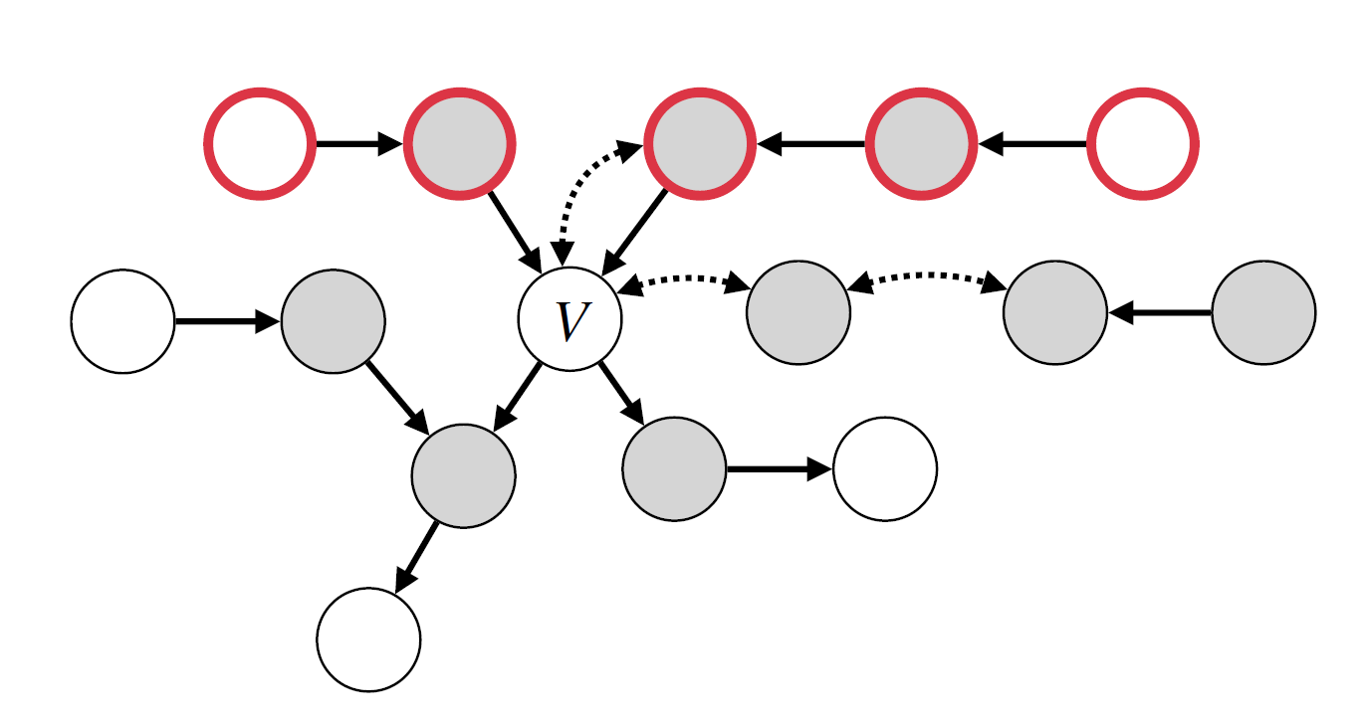
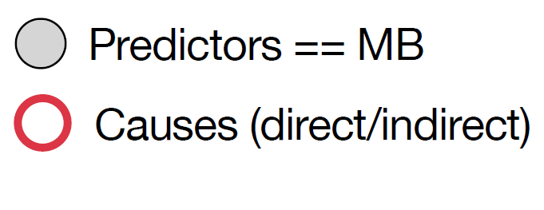
Graphically Explaining Causes and Predictors
Markov Blanket (MB) of
: the bidirected connected component
(district) of V (excluding itself) and the parents of the district of V, i.e.: mb_{G}(V ) = dis_{G}(V ) ∪ Pa_{G}(dis_{G}(V ))∖{V}
36

Slide 37
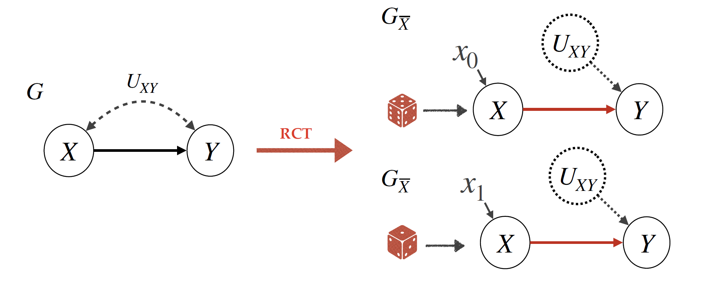
Randomized Experiments
Randomized Experiments / Control Trials (e.g. RCT) allow the identification of causal effects by leveraging randomization of the treatment assignment.

Slide 38
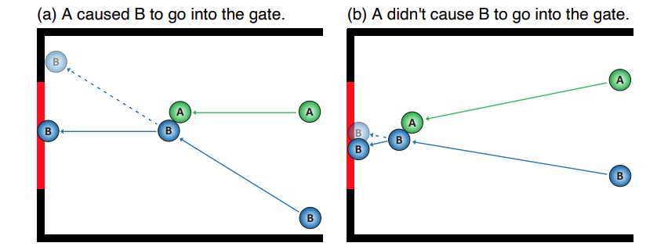
Pearlian Causality
A success story
The formalization with most success in AI/ML so far.
Works in Cognitive Science also in support of the key ideas in the formalism i.e., humans reason counterfactually.
Gerstenberg. What would have happened?[…] PTRBAE 2022.
Machines Climbing Pearl’s Ladder of Causation

Slide 39
Causality allows us to talk about modelling assumptions
Causality allows us to consider not just the joint distribution but the data generating process which induces said distribution
Machines Climbing Pearl’s Ladder of Causation

Slide 40
2
What? Does Pearlian Causality look like?
Machines Climbing Pearl’s Ladder of Causation

Slide 41
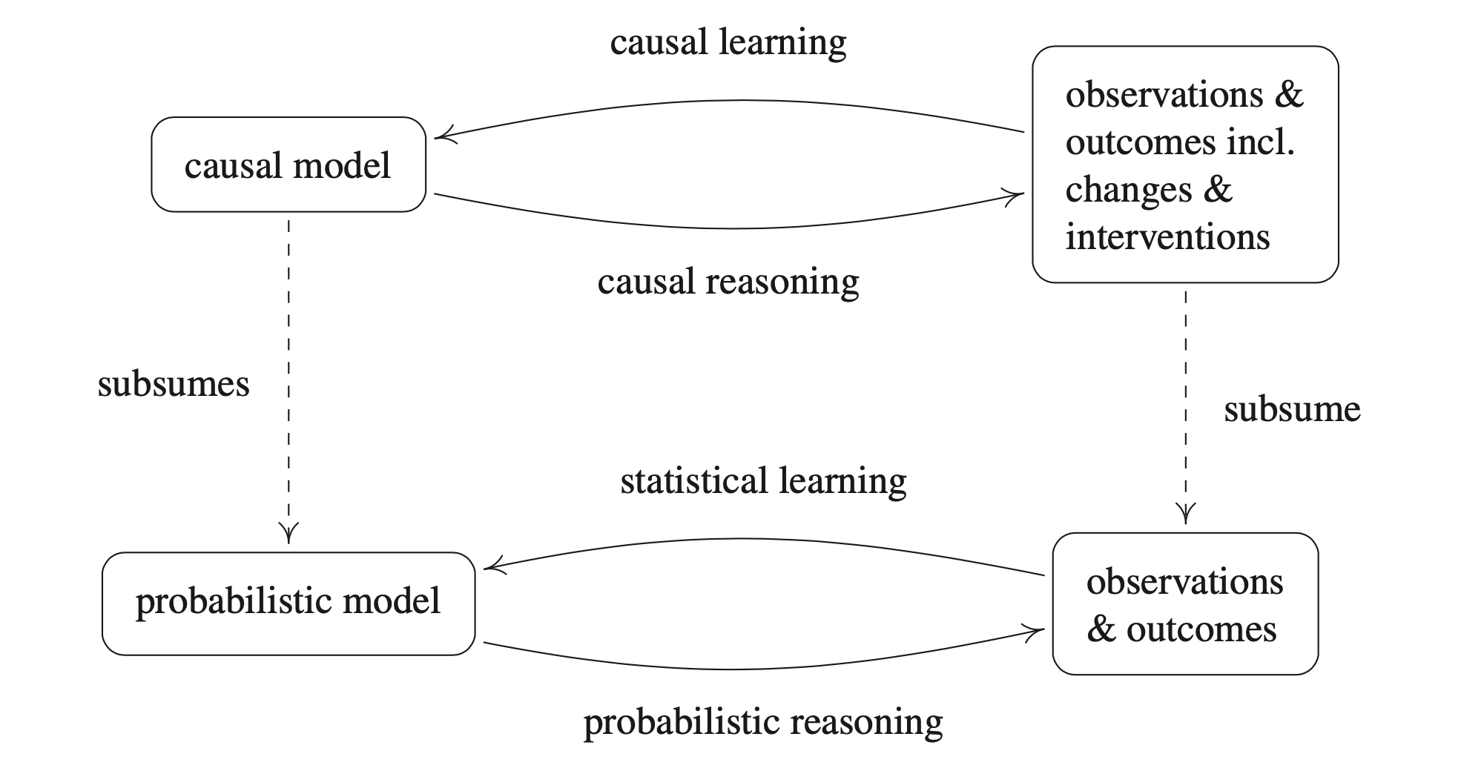
Causal versus Probabilistic Inference
Peters et al. 2017, Fig.1.1
Machines Climbing Pearl’s Ladder of Causation

Slide 42
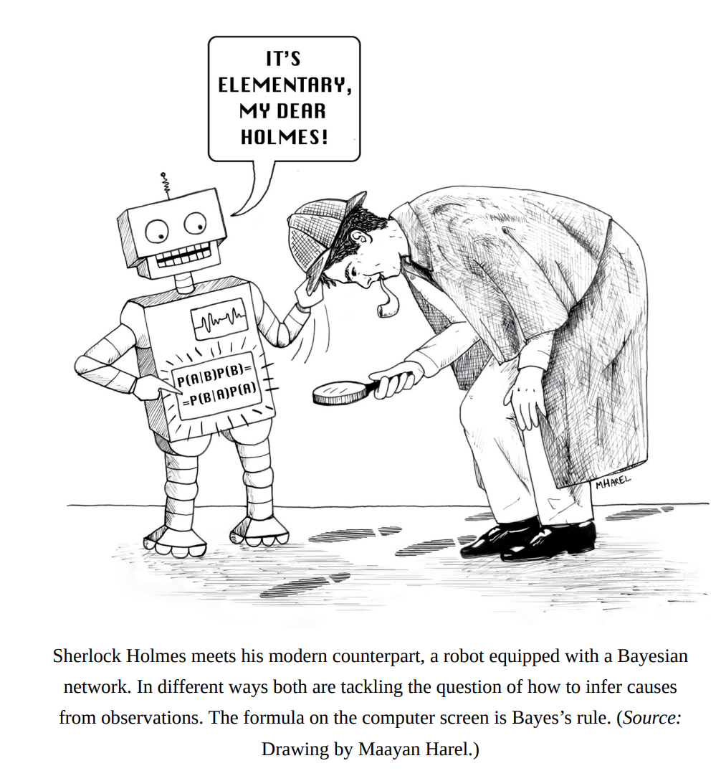
Pearl and Mackenzie, The Book of Why, 2017
Machines Climbing Pearl’s Ladder of Causation

Slide 43
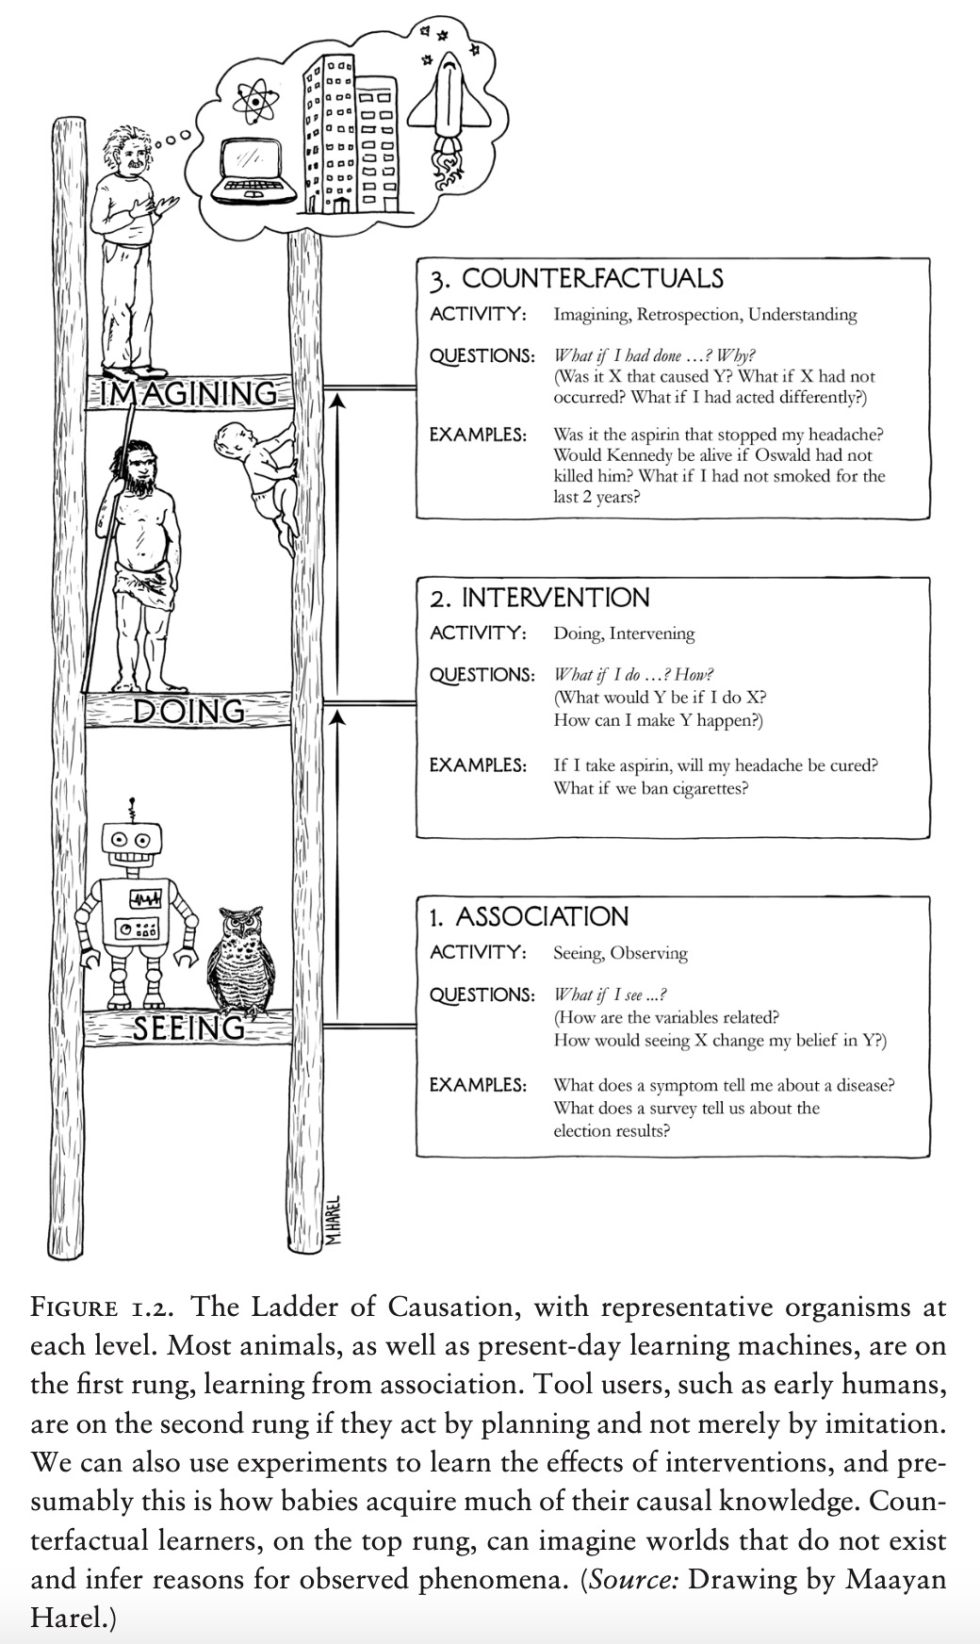
Pearl Causal Ladder Level I
Machines Climbing Pearl’s Ladder of Causation

Slide 44
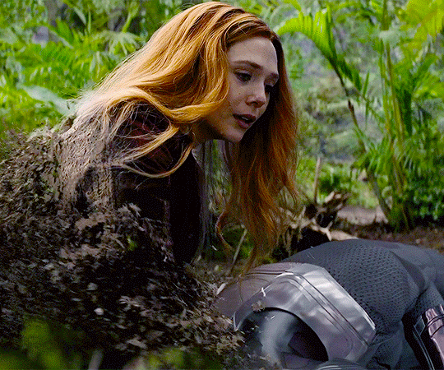

Machines Climbing Pearl’s Ladder of Causation

Slide 45
Pearl Causal Ladder Level II
Machines Climbing Pearl’s Ladder of Causation

Slide 46

Pearl Causal Ladder Level II
Machines Climbing Pearl’s Ladder of Causation

Slide 47

Pearl and Mackenzie, The Book of Why, 2017
Machines Climbing Pearl’s Ladder of Causation

Slide 48
Pearl Causal Ladder Level III
Machines Climbing Pearl’s Ladder of Causation

Slide 49

Pearl Causal Ladder Level III
Credit: https://forns.lmu.build/classes/spring-2019/cmsi-498/lecture-5T.html
Machines Climbing Pearl’s Ladder of Causation

Slide 50

Pearl’s Hierarchy
Machines Climbing Pearl’s Ladder of Causation

Slide 51
Structural Causal Model (SCM) Definition
A structural causal model (or data generating model) is a tuple , where
are endogenous variables
are exogenous variables
are functions determining V i.e.,
is the probability distribution over U.
Assumption: is recursive i.e., there are no feedback (cyclic) mechanisms
Machines Climbing Pearl’s Ladder of Causation

Slide 52
The Causal Graph An induced property of the SCM
Z
Headache
latent
X
Drug
Y
Disease
Machines Climbing Pearl’s Ladder of Causation

Slide 53
The 3 Basic Graphs: “gifts from the gods”
Chain
X
Y
X
Y
X
Y
Z
Z
Fork
Collider
Machines Climbing Pearl’s Ladder of Causation

Slide 54






Graphical Representation of an SCM
Structural Causal Model (SCM)
Graphical Causal Model (Causal Diagram)
V = {X, Y}
U = {U_{XY}, U_{X}, U_{Y}}
X = f_{X}(U_{X}, U_{XY})
Observational
U
XY
ℳ =
ℱ =
P(U)
{Y = f_{Y}(X, U_{Y}, U_{XY})
do(X = x)
do(X = x)
^{U}XY
V = {X, Y}
U = {U_{XY}, U_{X}, U_{Y}}
X = x
Interventional
do(X = x)
ℳ =
ℱ =
P(U)
{Y = f_{Y}(x, U_{Y}, U_{XY})
Machines Climbing Pearl’s Ladder of Causation

Slide 55

What is induced by the SCM?
Machines Climbing Pearl’s Ladder of Causation

Slide 56

Machines Climbing Pearl’s Ladder of Causation

Slide 57

Machines Climbing Pearl’s Ladder of Causation

Slide 58

Machines Climbing Pearl’s Ladder of Causation

Slide 59
Counterfactuals A 3-step procedure
Abduction : Update belief in exogeneous variables given evidence
Action : Change equations accordingly,
Prediction : Look at variable of interest
Machines Climbing Pearl’s Ladder of Causation

Slide 60

Association vs Causation
https://xkcd.com/925/ - Creative Commons Attribution-NonCommercial 2.5 License.
Will we be able to decide the true relationship just by “seeing” more data?
Mobile Phone
Cancer
or
Mobile Phone
Cancer
or
Mobile Phone
Cancer or
Mobile Phone
Cancer
?
60

Slide 61

Problems to be solved
Wen et al., Applying causal discovery to single-cell analyses using CausalCell, eLife 2023
Machines Climbing Pearl’s Ladder of Causation

Slide 62

Problems to be solved
Schölkopf et al., Towards Causal Representation Learning, Proceedings of the IEEE 2021
Machines Climbing Pearl’s Ladder of Causation

Slide 63

Problems to be solved
https://towardsdatascience.com/causal-effects-f30f962ffff3
Machines Climbing Pearl’s Ladder of Causation

Slide 64

Problems to be solved
Jin et al., Tutorial on Causal Inference for Natural Language Processing, EMNLP 2022
Machines Climbing Pearl’s Ladder of Causation

Slide 65
3
Machine Learning
for Causality: A Flavour
Machines Climbing Pearl’s Ladder of Causation

Slide 66

Probabilistic Circuits + Causality
Zečević et al., Interventional SPN, NeurIPS 2021
Machines Climbing Pearl’s Ladder of Causation

Slide 67

Counterfactual Sum-Product Networks
Busch et al., Computing Counterfactuals using SPNs, Fundamental Challenges in Causality Colloquim 2023; IJAR TBS
Machines Climbing Pearl’s Ladder of Causation

Slide 68


Experiment: Particle Collision
Obs
CF
cfSPN
A difficult problem: Particle simulation with gravity and collisions
Goal: cfSPN prediction should match true counterfactual simulation (CF)
I: Move the bottom particle to the right after some timesteps
II: Change the velocity of the top particle to slightly upwards at the start
I
II
Based on the code repository for particle simulation:
https://github.com/ineporozhnii/particles_in_a_box
Machines Climbing Pearl’s Ladder of Causation

Slide 69

Logic + Causality = Explanations
Zečević et al. 2022, Explanations of SCMs
Machines Climbing Pearl’s Ladder of Causation

Slide 70

Free Code Libraries Do it for you
DoWhy, https://github.com/py-why/dowhy
Machines Climbing Pearl’s Ladder of Causation

Slide 71

Free Code Libraries Do it for you
DoWhy, https://github.com/py-why/causal-learn
Machines Climbing Pearl’s Ladder of Causation

Slide 72



Pointers to Causal Inference References
Judea Pearl, “Causality”, Cambridge University Press, 2009.
Peters et al., “Elements of Causal Inference”, MIT Press, 2017.
Elias Bareinboim Lecture “Causal Data Science”, 2019. https://www.youtube.com/watch?v=dUsokjG4DHc
Brady Neal’s Free Online Course ”Introduction to Causal Inference”, 2020. https://www.bradyneal.com/causal-inference-course
Jonas Peters Lecture Series “Causality”, 2017. https://www.youtube.com/watch?v=zvrcyqcN9Wo
Machines Climbing Pearl’s Ladder of Causation

Slide 73




Causality Theory by Judea Pearl
Machines Climbing Pearl’s Ladder of Causation

Slide 74

Every Week with Paper Authors → Discuss LIVE
530 members on Slack
Join the community via discuss.causality.link

Slide 75

35+ Sessions Completed
and
All Recorded
…

Slide 76
Want to learn more about the genealogy of causality research?

Slide 77


Access via genealogy.causality.link
🌳

Slide 78


Access via genealogy.causality.link
🌳
To Extend This!

Slide 79
Join the community via discuss.causality.link
Access the genealogy via genealogy.causality.link

Slide 80
After having seen all this, we realize..
“As X-rays are to the surgeon, graphs are for causation.”
-Judea Pearl in Causality (2009)
Machines Climbing Pearl’s Ladder of Causation

